Slide 1
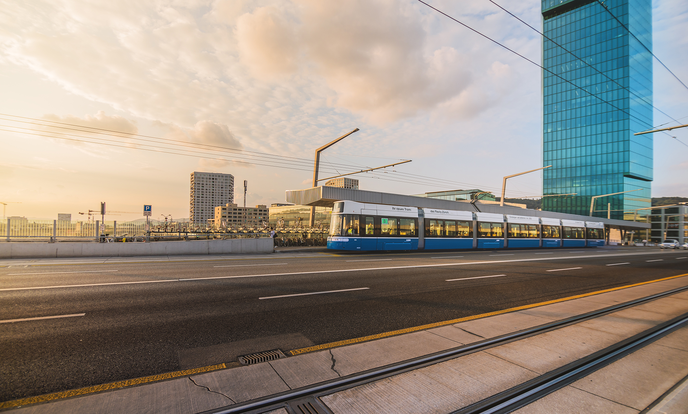
Data-driven decision-making with Shiny at Verkehrsbetriebe Zürich (VBZ)
Yana Neuenschwander / adminR / December 2022

Slide 2
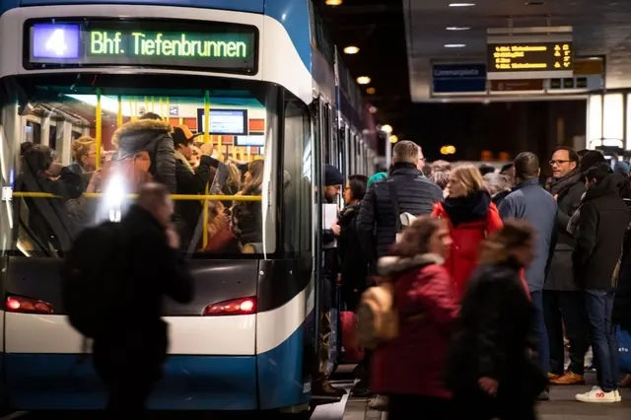



Public transport in Zurich
265 232 1
rail vehicles buses million passengers
per day
Source: Reto Oeschger, Tagesanzeiger
Improve the quality of public transport based on data

Slide 3
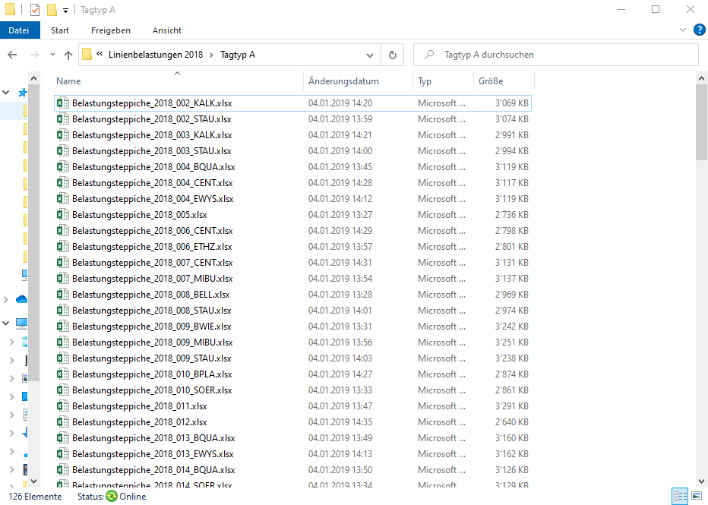
Analysing vehicle occupancy
The hard way

Slide 4
Analysing vehicle occupancy
The easy way
http://mad/

Slide 5





Analysing vehicle occupancy
The easy way
Team MAD
(Mobility & Data Analytics)
http://mad/

Slide 6








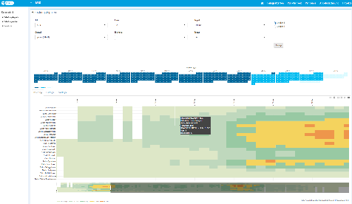
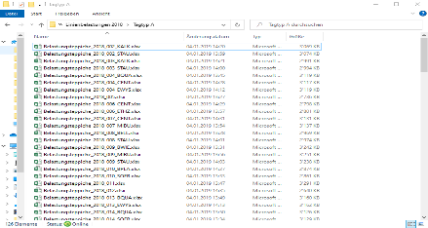

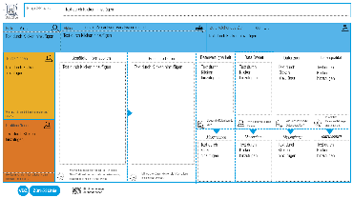
Dashboard development in collaboration with the users
Initialization phase
Realization phase
brainstorming
dashboard prototyping
dashboard development
finalizing dashboard
assignment from
VBZ expert
iterative
workflow
definition of project goals
and clarification of data
requirements
feedback and progress discussion
presenting dashboard to end user

Slide 7
Dashboard development in collaboration with the users
Initialization phase
Realization phase
brainstorming
dashboard prototyping
dashboard development
finalizing dashboard
assignment from
VBZ expert
iterative
workflow
definition of project goals
and clarification of data
requirements
feedback and progress discussion
presenting dashboard to end user
User feedback on custom-tailored dashboards

Slide 8

Analysing vehicle occupancy
R package catmaply
The externally commissioned open source CRAN package
catmaply is based on Plotly and used for advanced but
comprehensible visualizations of the vehicle occupancy.
https://github.com/VerkehrsbetriebeZuerich/catmaply

Slide 9



Problem solved? Not quite..
???

Slide 10
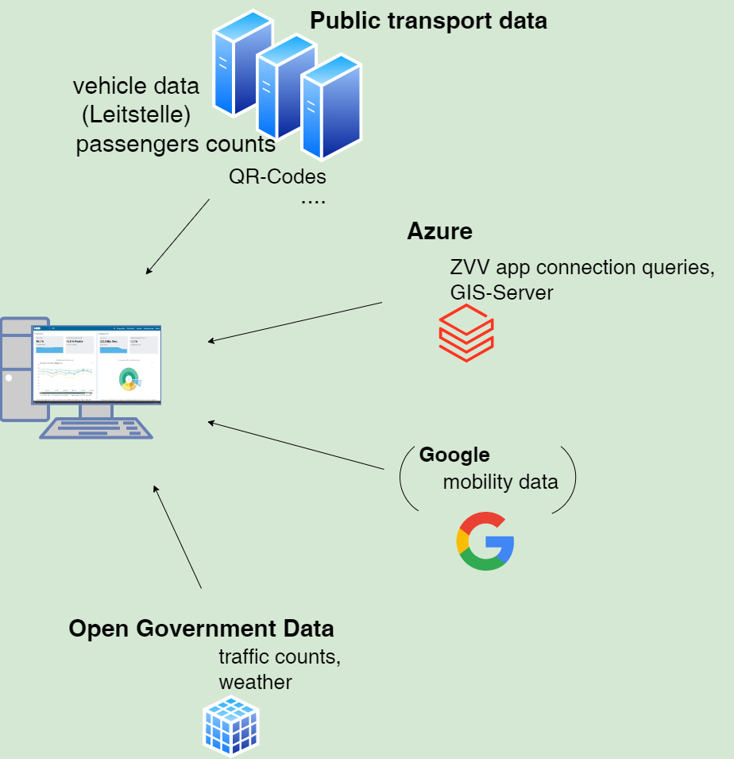
Backend limitations
Hosting currently based on non-enterprise Shiny Server → users wait
Increasing number of reports based on big amount of data from multiple data sources → limited performance
Notes:
Zugänglichkeit muss jederzeit gewährleistet werden

Slide 11
Increasing number of end users at VBZ
✓
Director
Corporate Staff
Corporate Communications
✓
✓
✓
Operations
Market
Technology
Infrastructure
Finance & Services
Human Resources

Slide 12
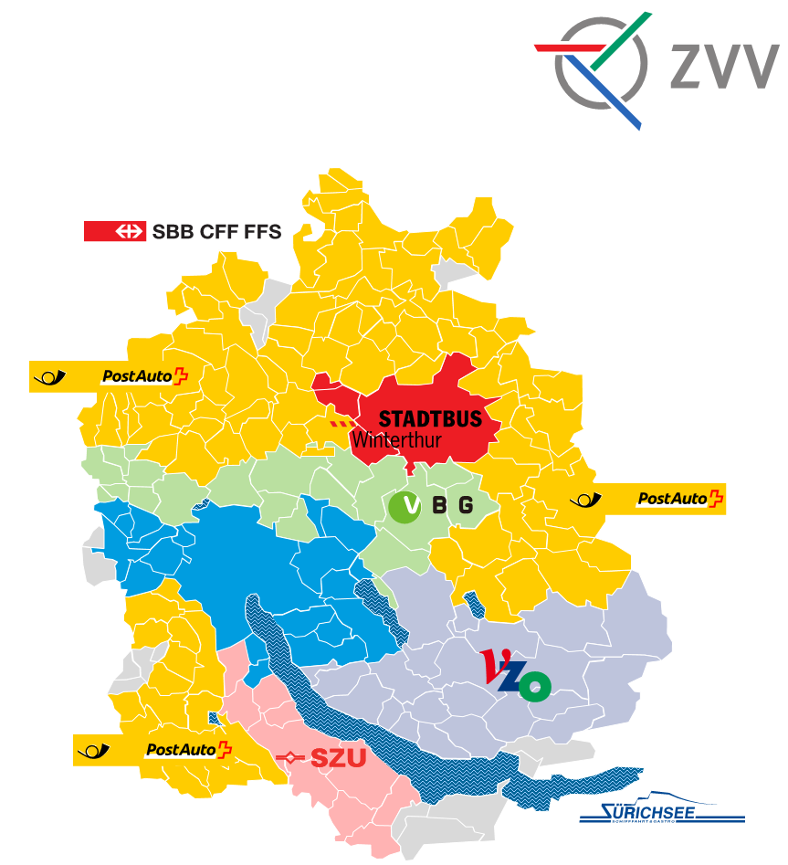

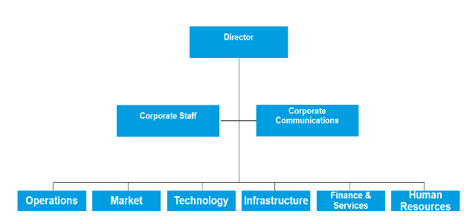
Currently restricted access to the Shiny dashboard
Dienstabteilung Verkehr
Tiefbauamt
✓
VBZ

Slide 13
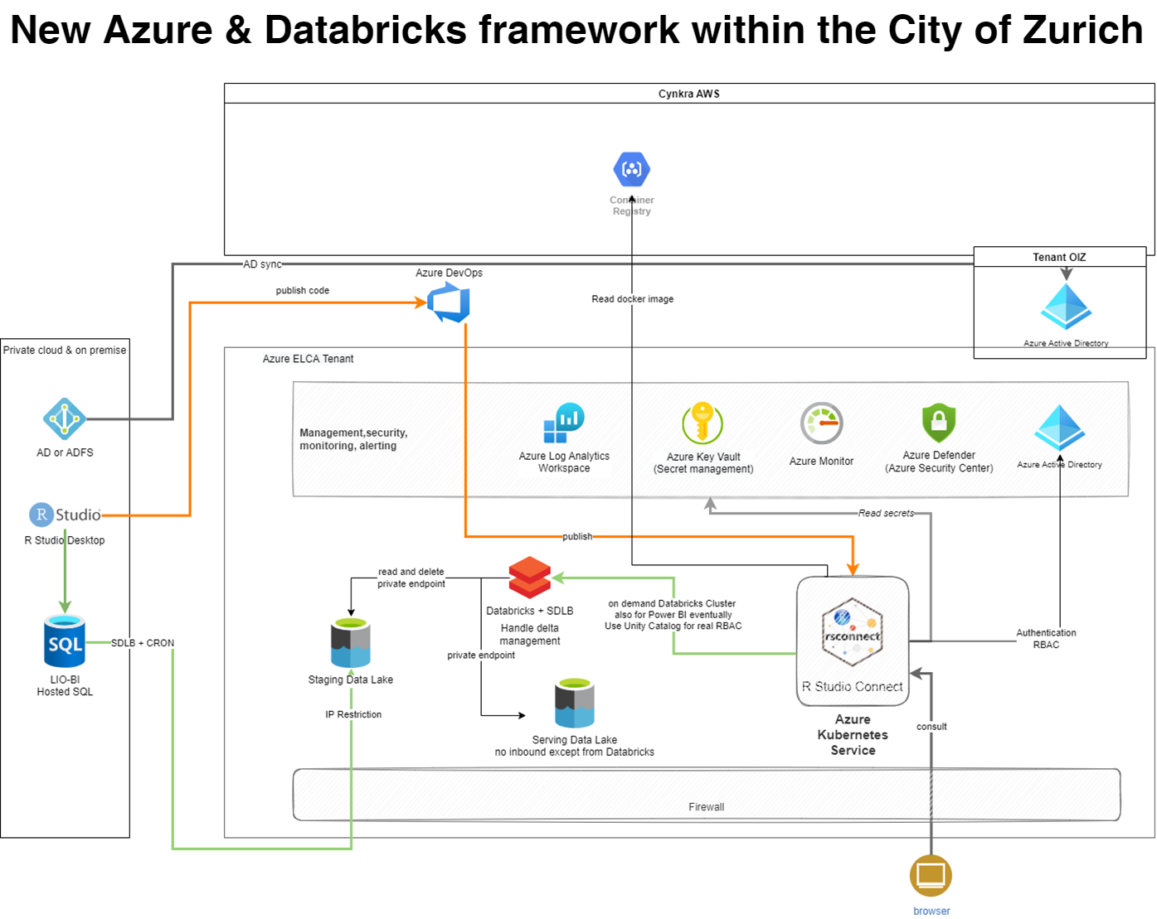
Solution: New Azure & Databricks framework within the City of Zurich
One platform for everything (analytics, development and hosting of Shiny apps) → joint use within the City of Zurich possible
Apps hosting via RStudio Connect → performance, user management, statistics, working with different R versions
Access to hosted apps for further user groups
Notes:
Technical background

Slide 14
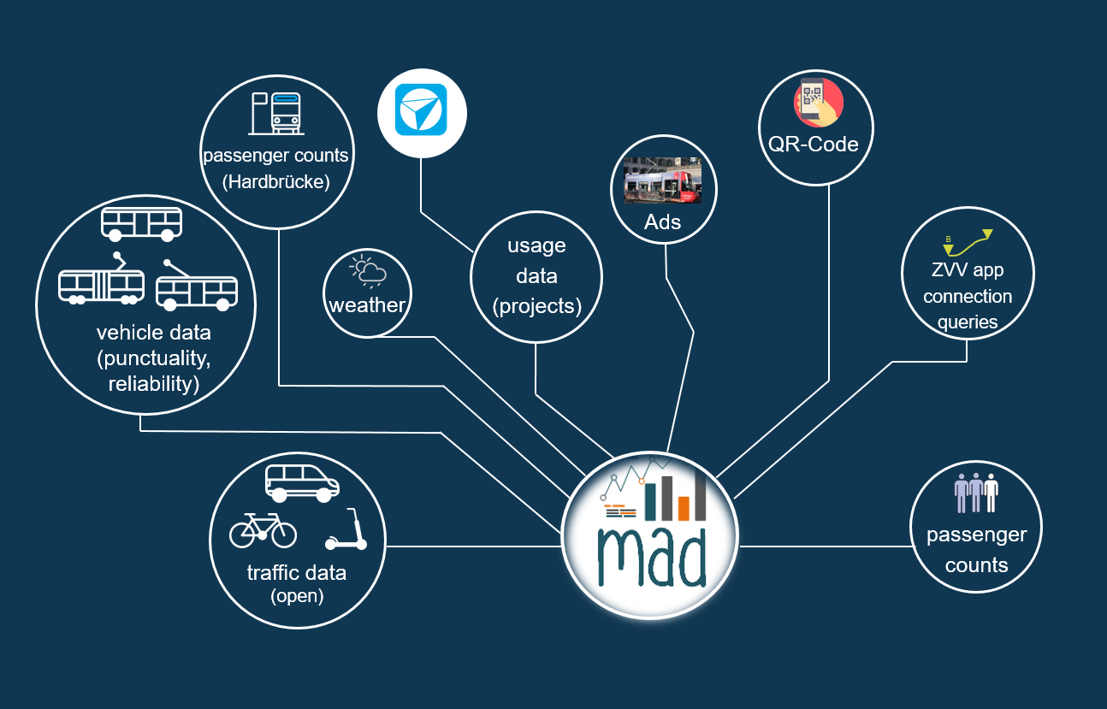
Data landmap MAD dashboard

Slide 15
Concluding thoughts and outlook
With R and Shiny the users requirements at VBZ are fully met
Further insights regarding dashboards usability and usage statistics needed
New R / Shiny analytics platform greatly improves the accessibility of data and analytics tools for a broader audience in the City of Zurich

Slide 16

Thank you for your attention

Slide 17
Appendix

Slide 18
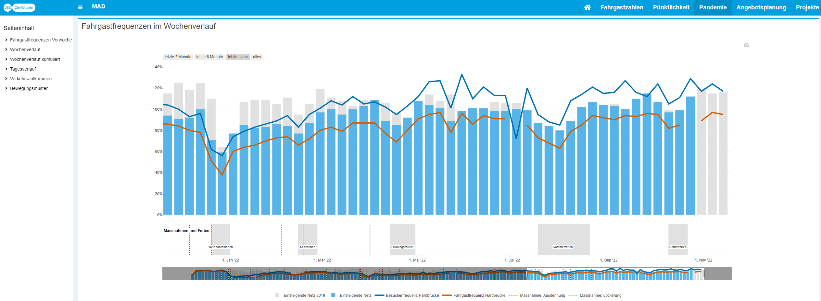
Design principles: Focus on usability
Higher recognition value through uniform design
(same colors, fonts, functions, position etc.)
One analysis
per box
Reports order from general at the top to very detailed at the bottom
Dynamic elements enable more flexibility and thus individualization
despite pre-defined graphical representation

Slide 19
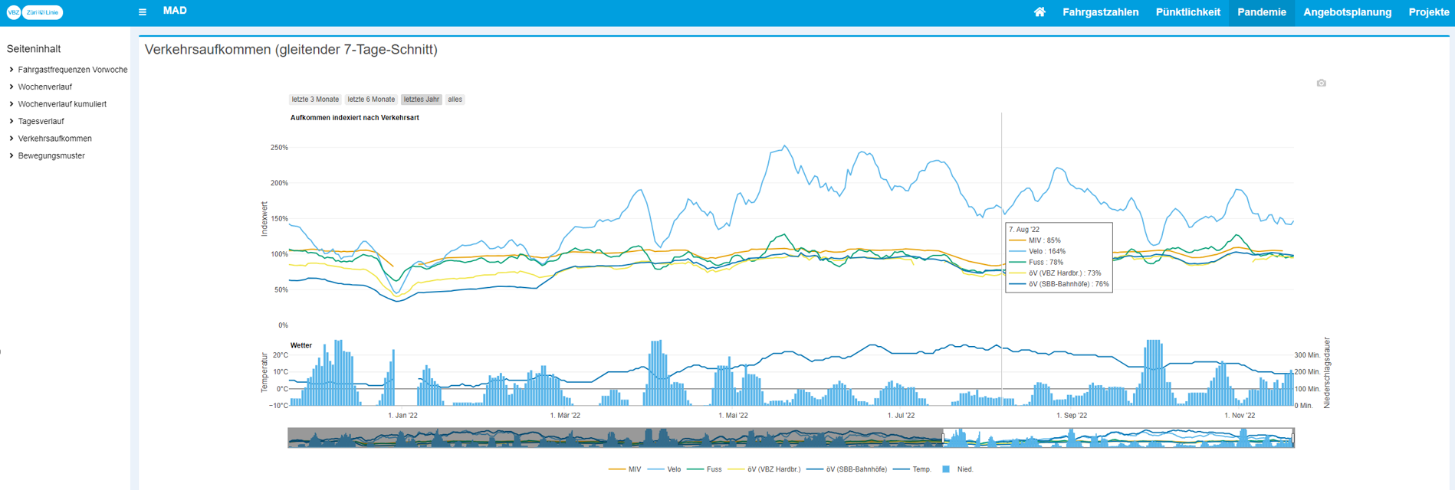
Design principles: Generating useful insights
Putting development of public transport data into context by
comparison with e.g. other mobility data and weather information

Slide 20
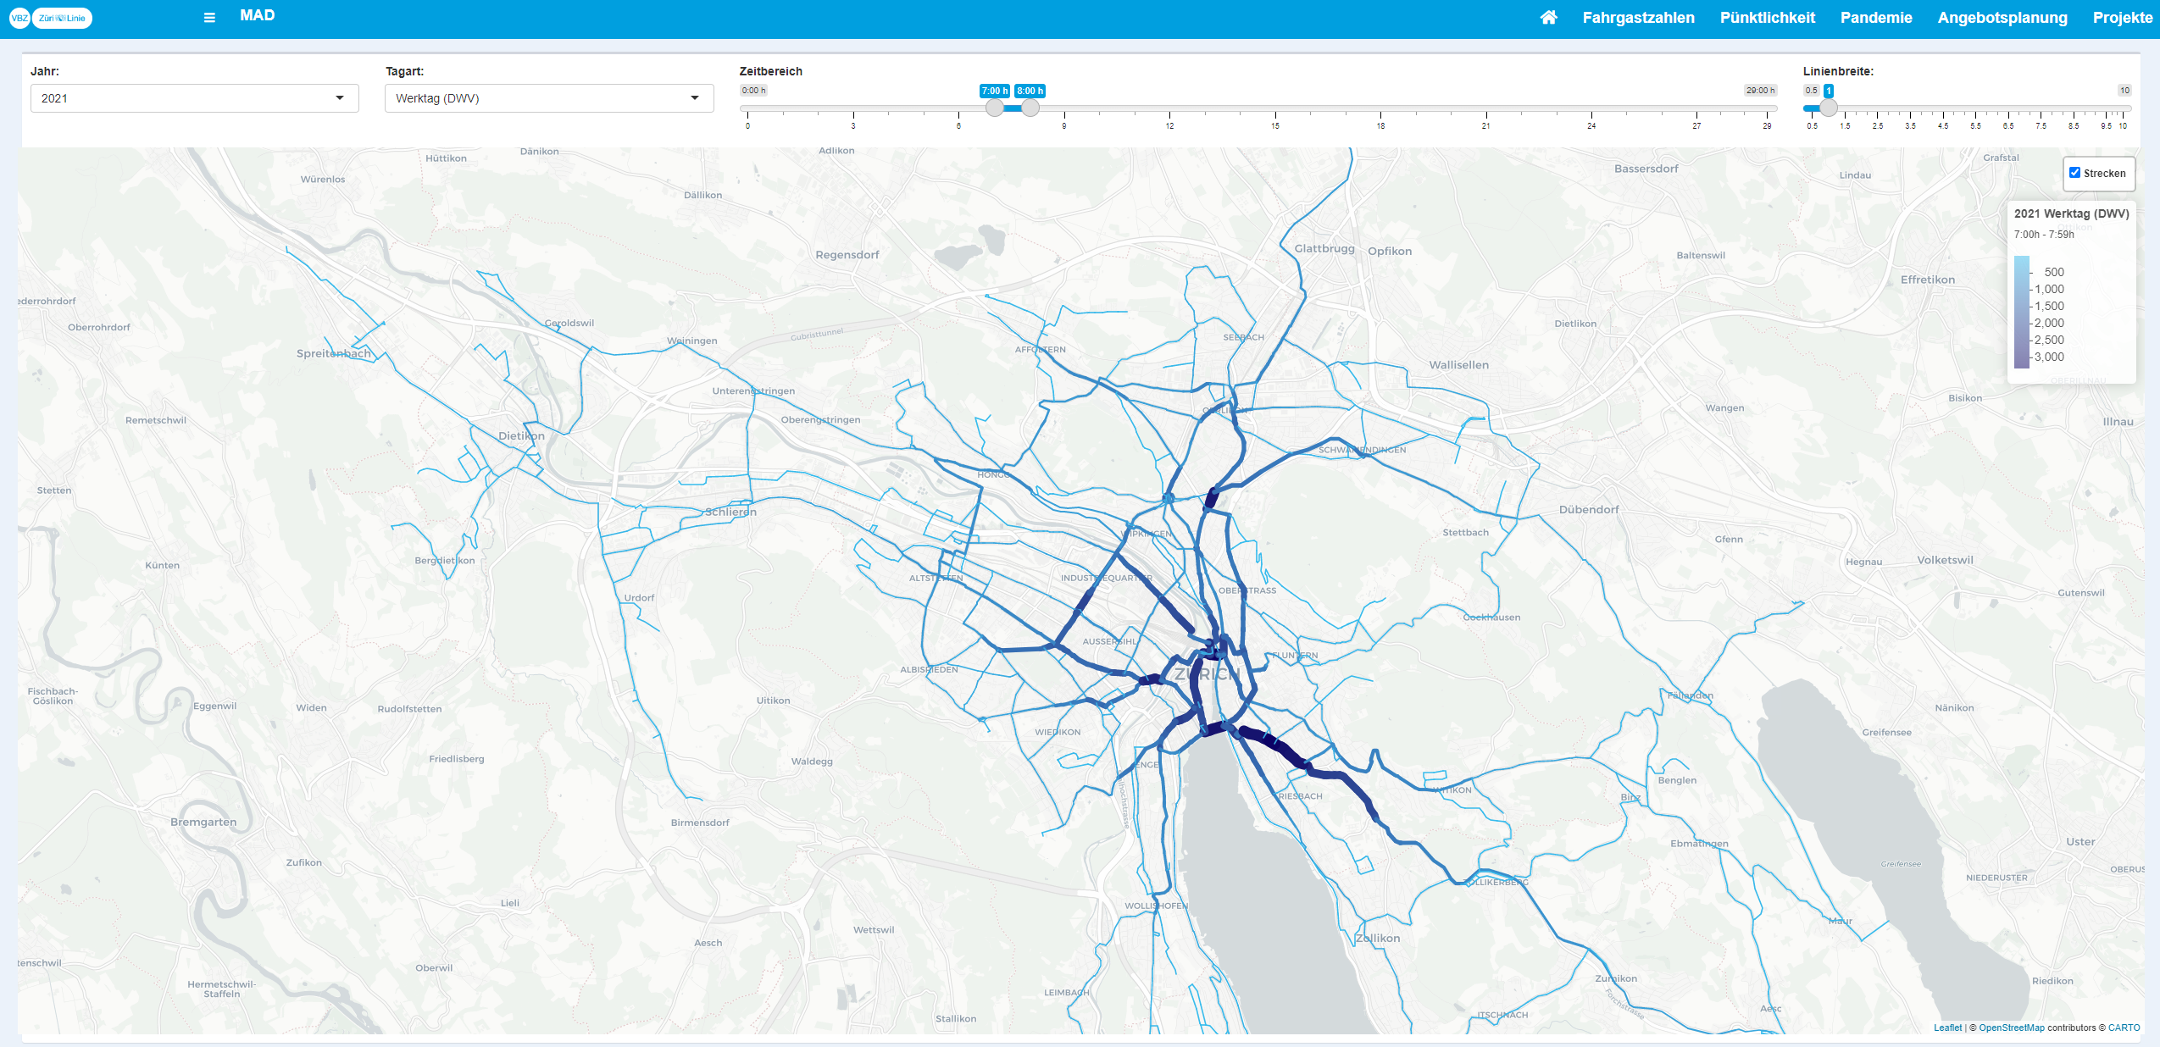
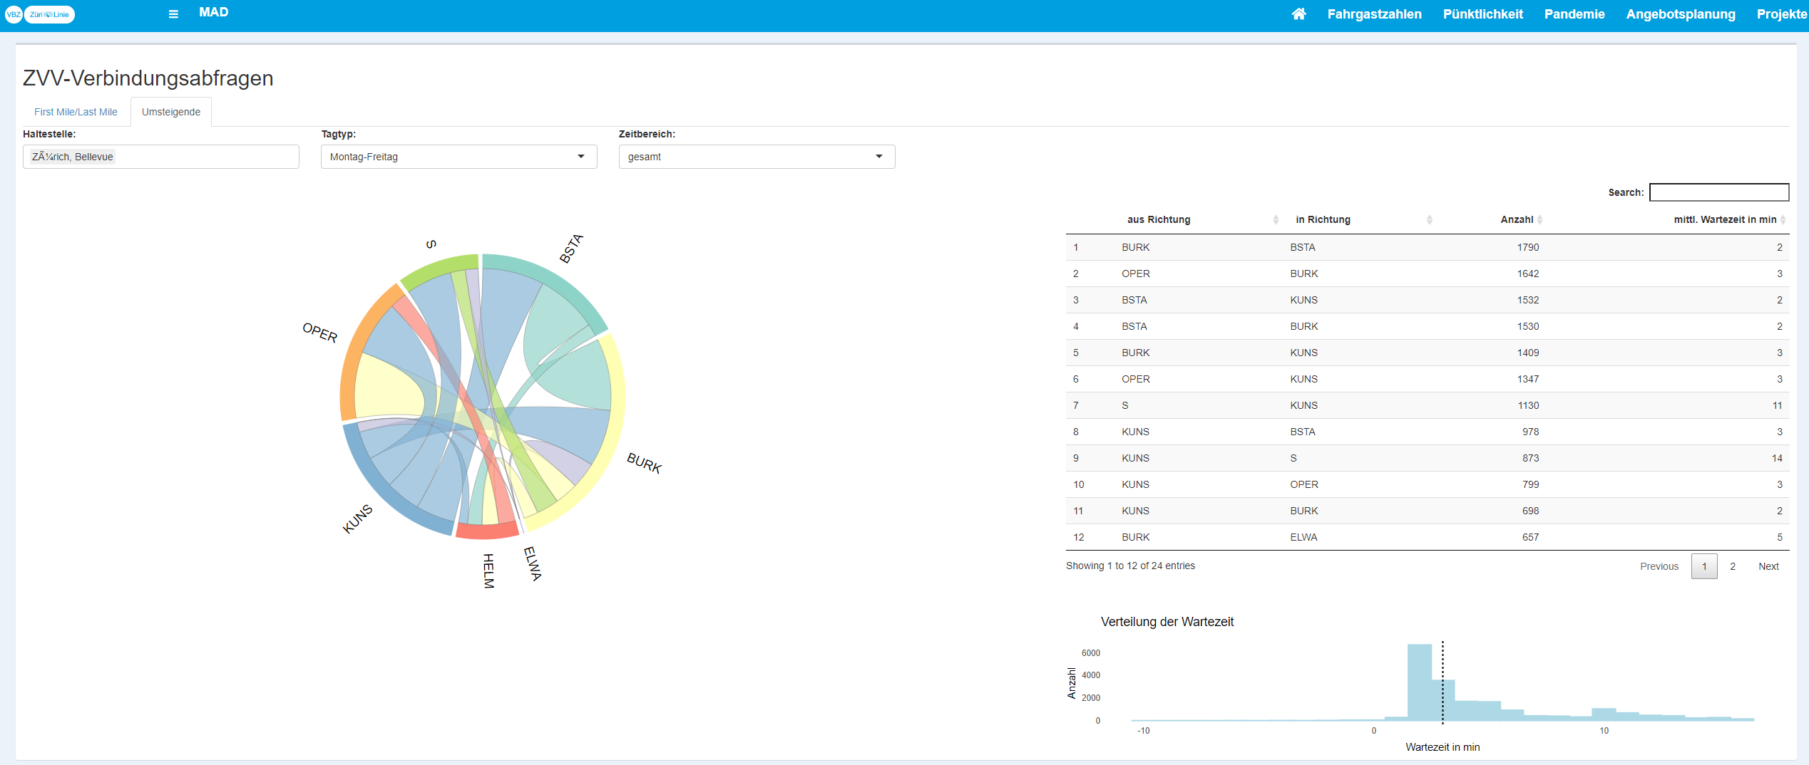
Depicting differences in passengers distribution along the bus and tram lines with Leaflet
Lines change streams based on connections requests data from the ZVV app and website, illustrated with chord diagram

Slide 21
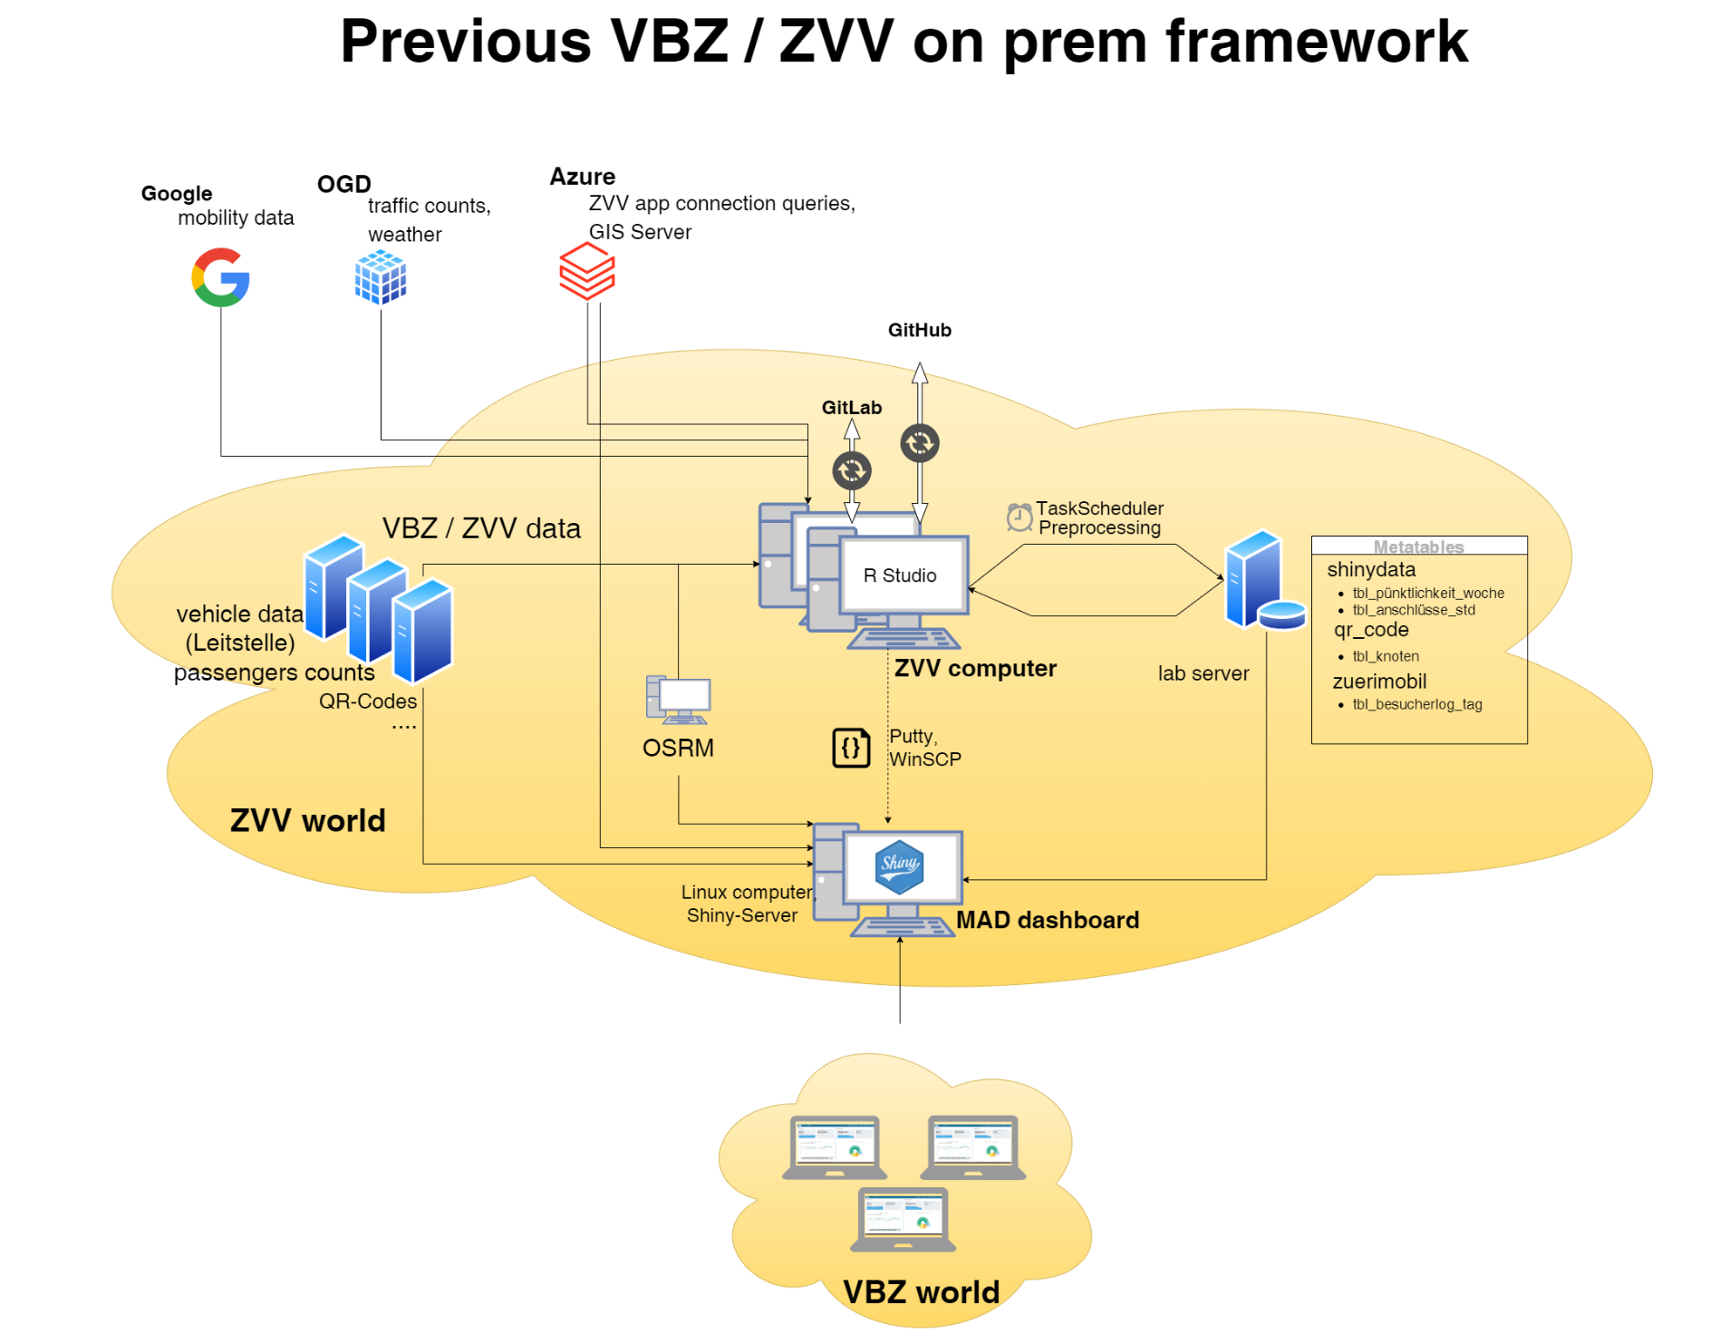
Only one active Shiny process at a time due to non-enterprise Shiny Server → users wait
No access to Shiny apps for users outside VBZ and ZVV
One platform for everything (analytics, development and hosting of Shiny apps) → joint use within the City of Zurich possible
Apps hosting via RStudio Connect → performance, user management, statistics, working with different R versions
Access to hosted apps for further user groups
Notes:
Technical background

